Slide 1
San Diego Airbnbs - Decoding High Booking Rates

Slide 2





Team Fab 5
Ben Stafford
Vikas
Agastya
Samhitha
Srinivas

Slide 3
Agenda
01
Kaggle Competition
02
Intro to San Diego
03
Initial Insights
04
Model Development
05
Findings
06
Conclusion

Slide 4
Kaggle Competition
Data pre-processing:
Data Filtering
Dropping Irrelevant Columns
Feature Engineering
Data Imputation
Handling Data Imbalance
Model Development and Trials:
Initial Model Trials
Choosing model
Notes:
Vikas

Slide 5
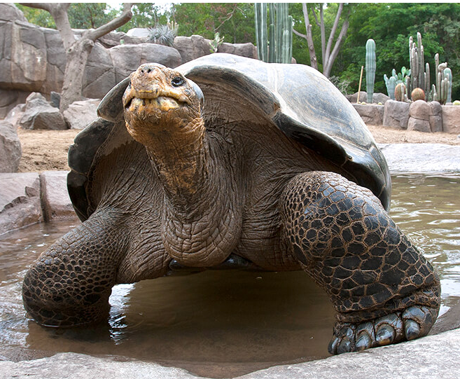


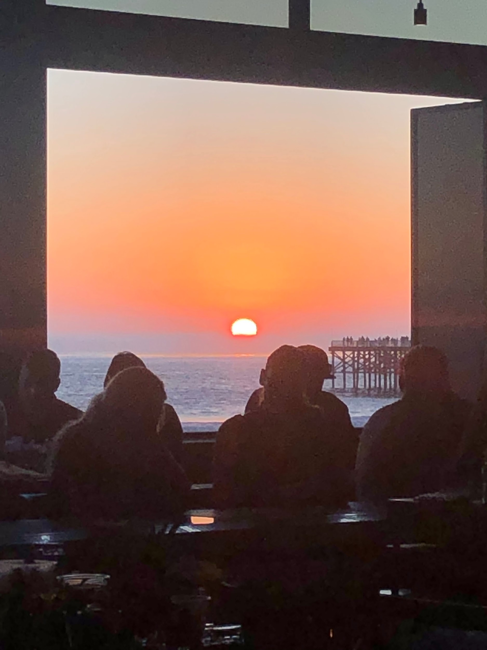
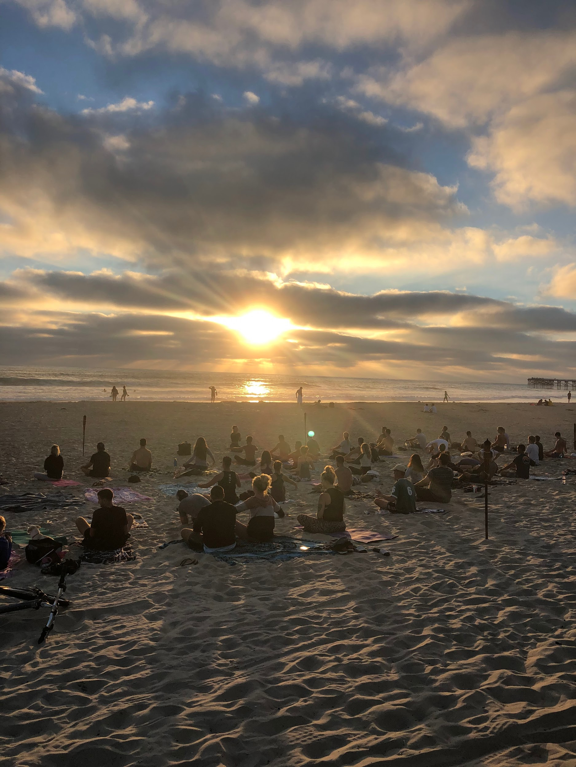



San Diego - The Destination
Location
Climate
Attractions & Entertainment
Notes:
Named “Americas finest city” and although this may be a self-proclaimed title that we pulled from SanDiego.gov, if you’ve ever had the pleasure of visiting, it really is one of the nicest cities in America.
In any month that you visit the temperature will likely be above 70 degrees and on average they only receive about 10 inches annually. I think we can all agree there is nothing worse than taking a vacation and it rains the entire time. Well in San Diego that is never something you need to worry about. The constant sunshine and warmth of Southern California, mixed with the refreshing ocean breeze gives San Diego a tranquil climate that is perfect for every type of traveler.
There is great weather, perfect sunny beaches, and even some of the best attractions in the world. The San Diego Zoo is the 5th largest zoo in the US and it has one of the biggest collections of rare and endangered animals in the world, including the Galápagos tortoise. It’s truly an amazing place to visit and now that you are all fantasizing about visiting San Diego, we will get into some of our exploratory data.

Slide 6
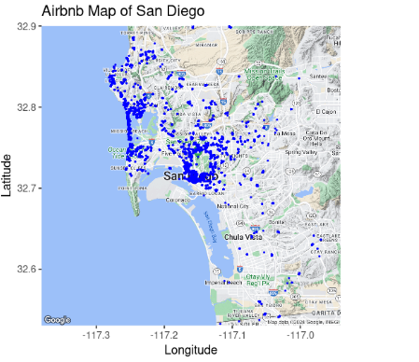
San Diego - Airbnb Market
Notes:
Srinivas.
Airbnb market description - rules + regulations

Slide 7
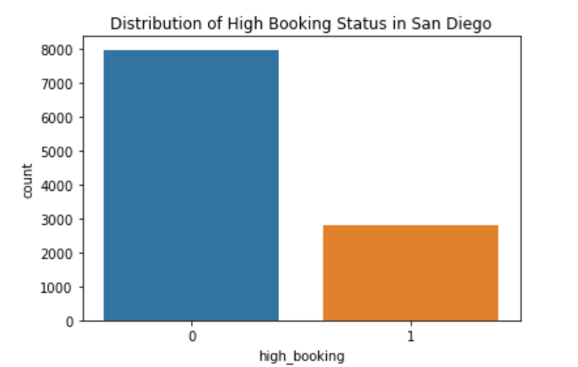
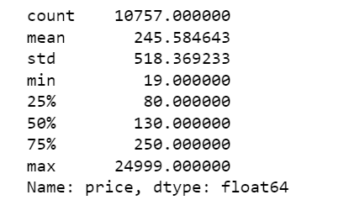
San Diego - Airbnb Market
Descriptive Statistics - total listings, how many with high bookings, mean price, median price,
Notes:
Srinivas.
Airbnb market description - rules + regulations

Slide 8
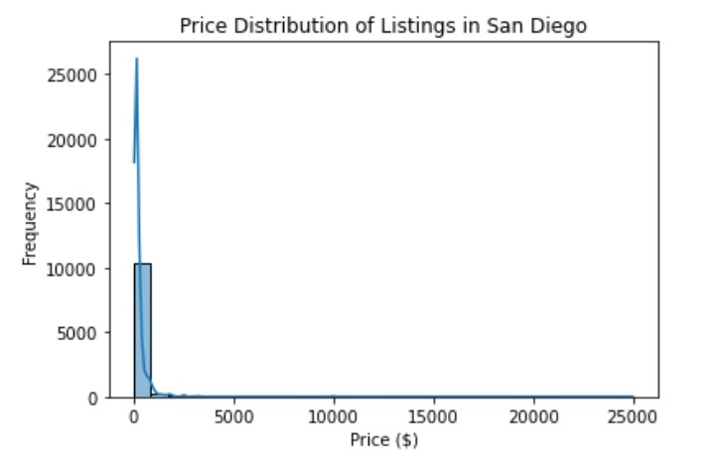
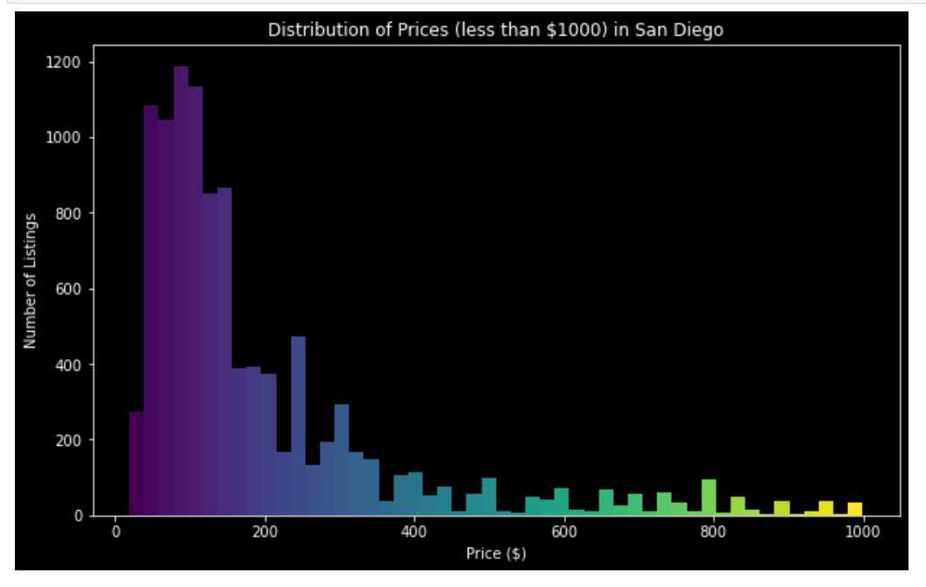
San Diego - Airbnb Market
EDA
Notes:
Srinivas.
Airbnb market description - rules + regulations

Slide 9
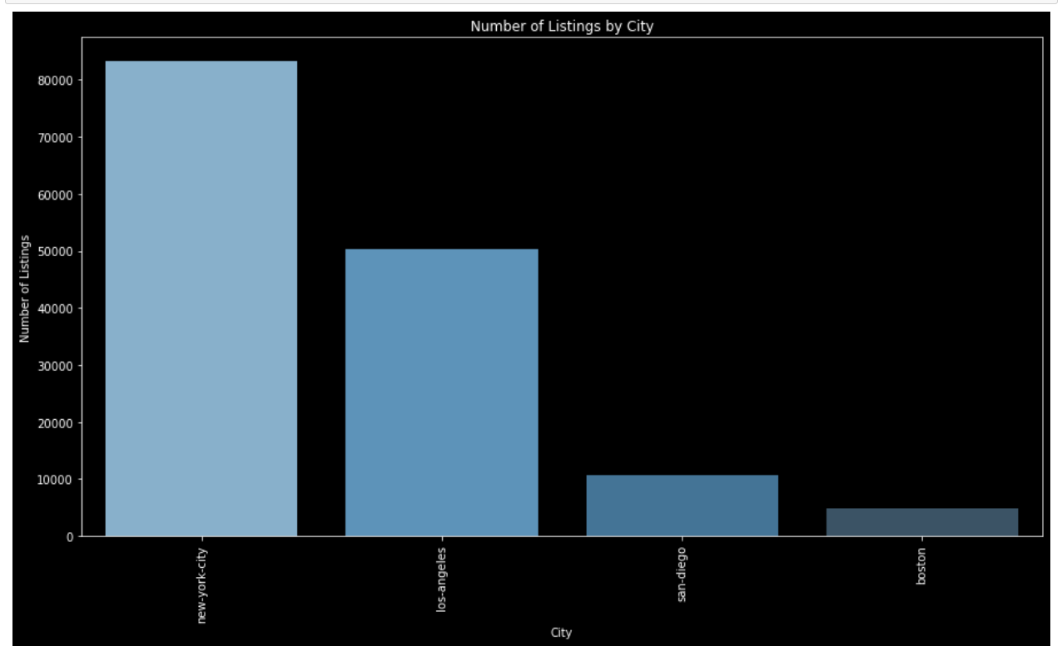
San Diego - Airbnb Market
EDA
Notes:
Srinivas.
Airbnb market description - rules + regulations

Slide 10
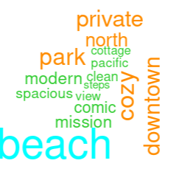
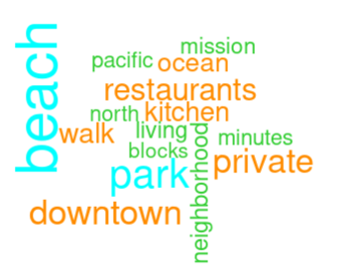
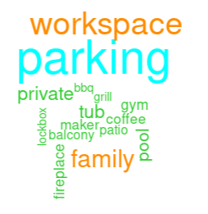
Initial Insights
10,757 listings analyzed
2,788 high booking properties
High booking rate: 26%
30.8% superhosts
Average price per night: $245
Median price per night: $130
Word Cloud Insights - Most frequent word: "Beach"
Other important words - "downtown," "restaurants," "private"
Amenities Insights - Key amenities : parking, workspace, bbq, grill, patio, pool, fireplace
Listing Names
Listing Descriptions
Amenities
Notes:
Samhitha
We analyzed 10,757 observations and identified 2,788 high booking properties.
The high booking rate stands at 26%, consistent with the overall dataset rate of 25.8%.
30.8% of hosts are superhosts, slightly above the 30.1% across all markets, indicating a mature and potentially growing market.
The average price per night is $245, with a median price of $130, suggesting a right-skewed distribution influenced by luxury listings.
Focusing on prices under $500/night, the data is more normally distributed.
The Word cloud for frequently used words in description/names is the word Beach which stands out, nearly double the next most used word. This word draws people in.
And the other important words are downtown, private, restaurants, which says most people love being close to the action.
And from Amenities, We pulled out the most important amenities like parking, workspace, bbq, grill, patio, pool, fireplace and encoded as their own column

Slide 11
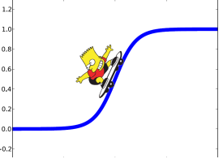
Model Development
Our Approach: Act as a consultant for current Airbnb Hosts
Goal: Advise as to how to make quick, easy, and affordable changes to their listing to improve their booking rates
Method: Logistic regression to provide interpretable insights
Notes:
Our goal was to review moderately priced Airbnbs to tailor our research to be targeted towards “regular” consumers. We mention “regular” because controlled our focus to customers in a middle-class range. The prices per night ranged from $19 to $25,000 but we found that 75% of all listings fell between $100 and $400 so these listings are where we applied our analysis and what we would be looking to advise on. Our goal was to act as a consultant, that current Airbnb hosts can hire to advise them on how to increase their booking rates. This is why we focused on this middle-class group of listings, because it has by far the largest number of potential clients, and our analysis could be considered relatively equal across all listings, not skewed by price.
With this in mind, we did not focus much on variables such as bedrooms, bathrooms, square footage, and many other variables in this dataset that are fixed in the short term. With our goal being to advise current hosts, it would not do them any good to say “add an extra bathroom and another 1,000 square feet to your home”, which is not an attainable short term goal, not to mention very costly.
We aimed to provide quick and easy suggestions to hosts that could help them drive up their booking rates in the short term, and with this in mind we focused our efforts on analyzing variables that can be easily manipulated.

Slide 12
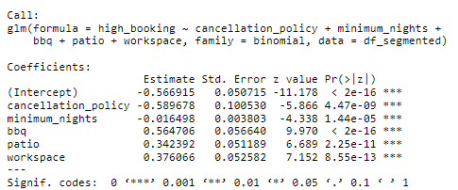
Findings
Cancellation Policy: Each unit increase in cancellation policy decreases high booking odds by approximately 45%.
Minimum Nights: Each additional night required minimum decreases high booking odds by approximately 1.6%.
BBQ: Presence of BBQ amenity increases high booking odds by approximately 76%.
Patio: Presence of Patio amenity increases high booking odds by approximately 41%.
Workspace: Presence of Workspace amenity increases high booking odds by approximately 46%.
Notes:
The variables we chose were based off our intuition as well as variable selection using lasso. We ultimately focused on 5 variables:
To interpret the results of our logistic regression model we looked at the odds ratios by calculating the exponential function for each coefficient. The odds ratios provide a clearer understanding of how each predictor variable influences the likelihood of high bookings.

Slide 13
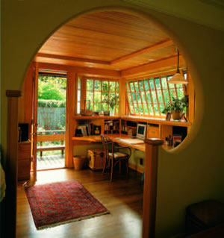
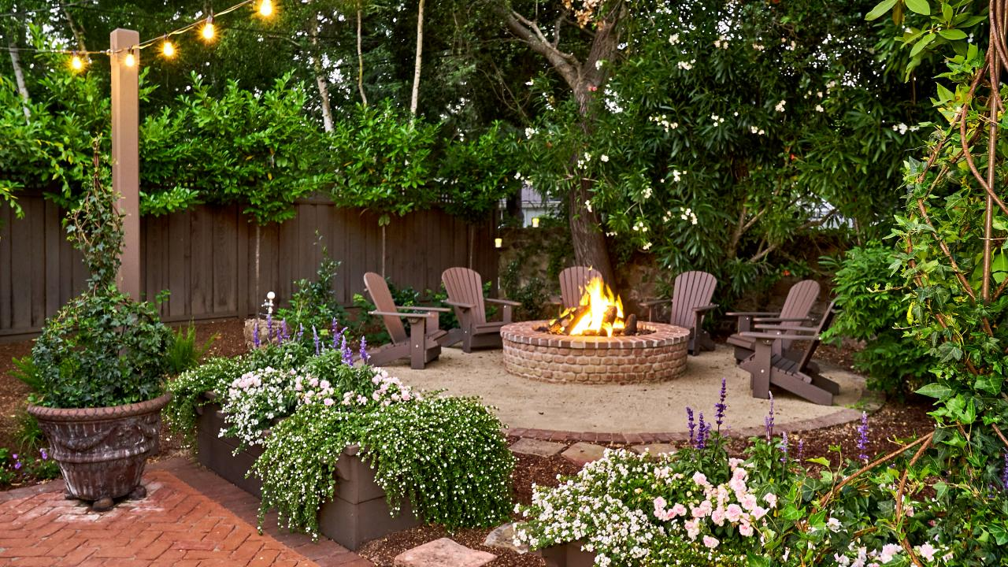
Advice to Clients
Allocate a budget and make changes to areas you can control
Perceived risk is not does not always come to fruition
Focus on simple upgrades that enhance your backyard or in home workspace
Notes:
“Make changes to the aspects of your listing that you can control in the short term. While may be a risk to implement a lenient cancellation policies or reduced minimum stay requirements, we expect the reward to outweigh the risk. People always want the peace of mind to have the option to cancel and get their money back, but rarely ever do. Even if you can't adopt the lowest options, consider modest adjustments for a trial period and gauge results. For amenities, we suggest creating a budget you are comfortable with and applying it to areas such as improving outdoor spaces with additional seating, grills, or even lawn games, as well as enhancing indoor workspaces for those targeting business travelers. These cost-effective upgrades can attract a broader consumer base, ultimately boosting bookings and revenue.”

Slide 14
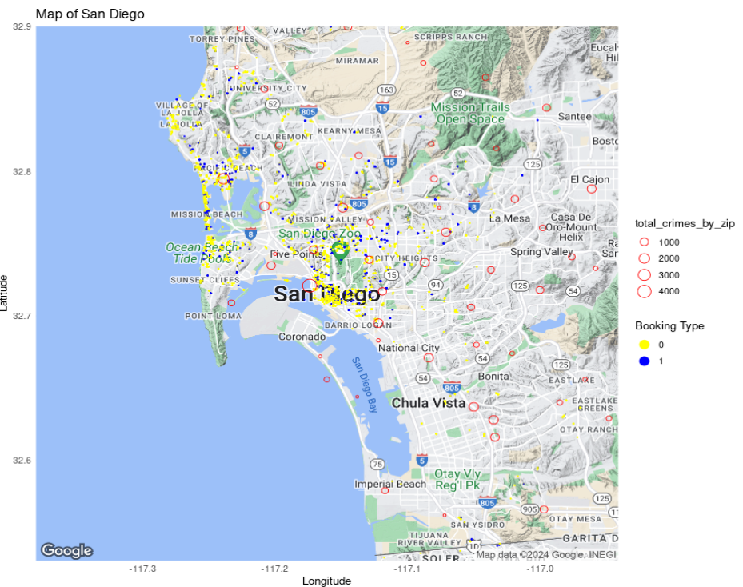
Conclusion
Future development
Implement a seasonality effect
How to influence the Airbnb Algorithm - gain more views and conversions
Add Crime by zip code and compare vs. Airbnb high booking rates

Slide 15
Thank You

